Slide 1
DVD Rental System
Group members:
Aainaa Nabilah Binti Rohaizad (B031810373)
Elle Aliz Binti Aminuddin (B031810295)
Gion Min Ming (B031810222)
Nur Alis Sophia Bini Suhaimi (B031810299)

Slide 2
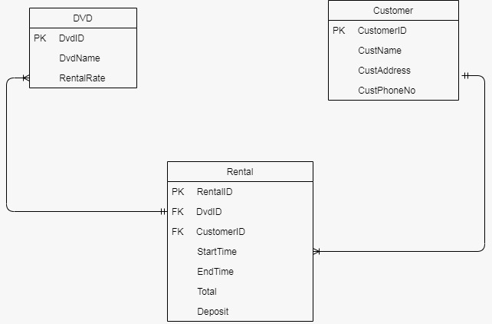
ERD

Slide 3
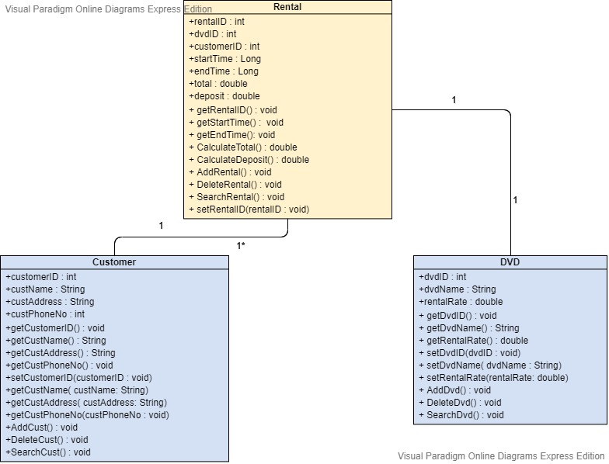
UML

Slide 4
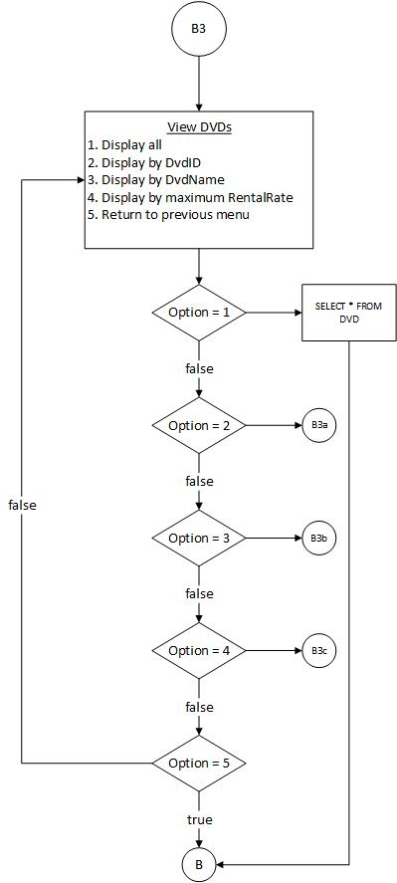
Flow Chart

Slide 5
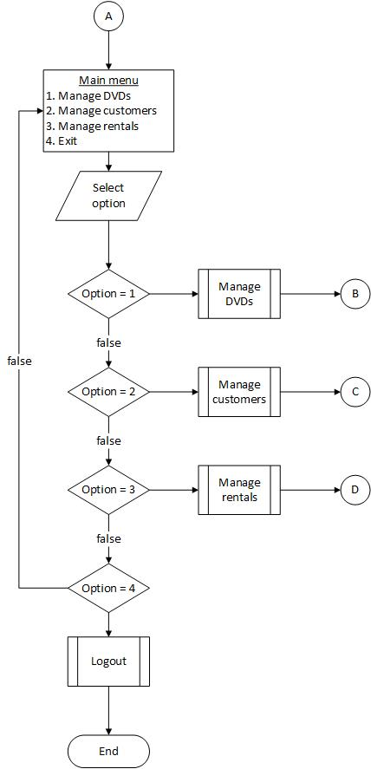

Slide 6
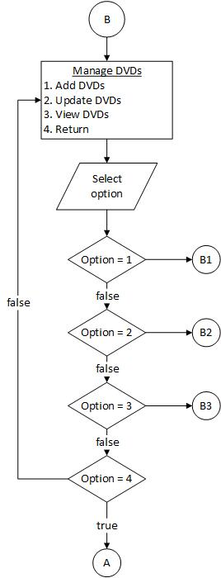

Slide 7
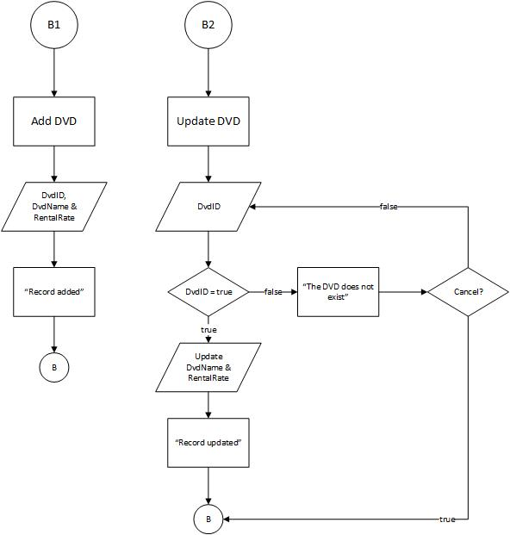

Slide 9
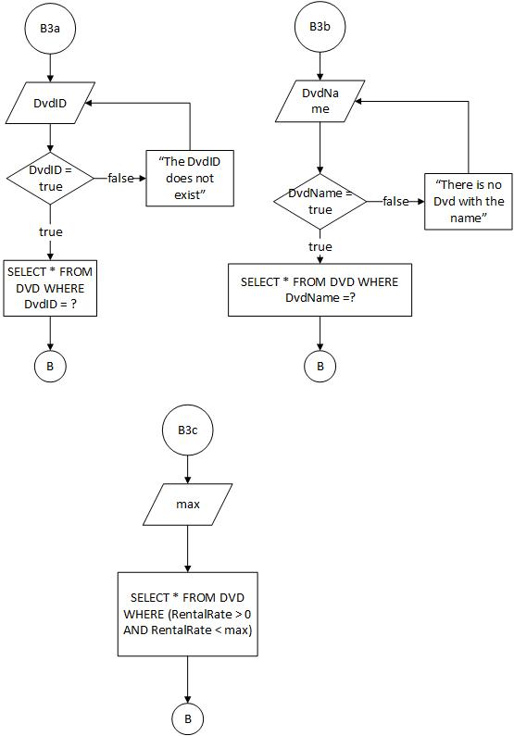

Slide 10
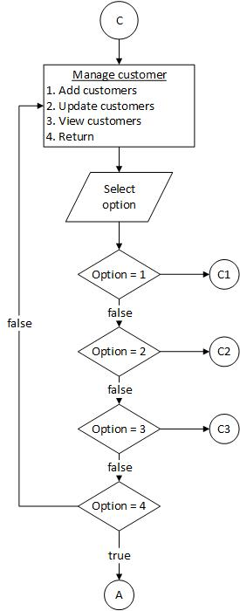

Slide 11
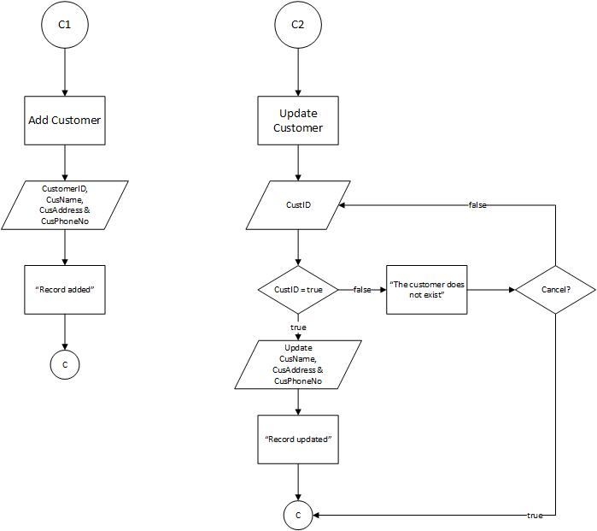

Slide 12
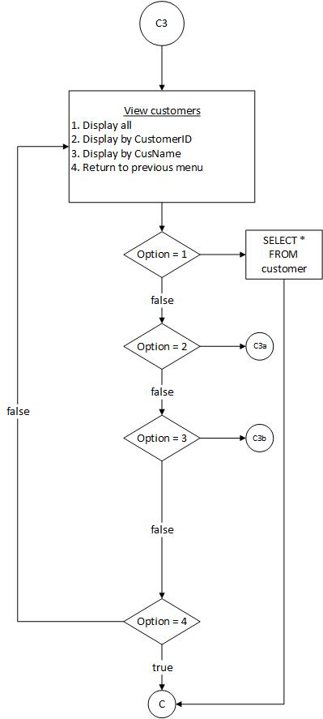

Slide 13
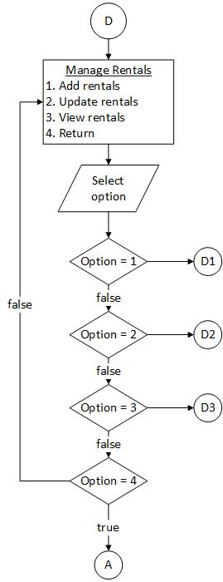

Slide 14
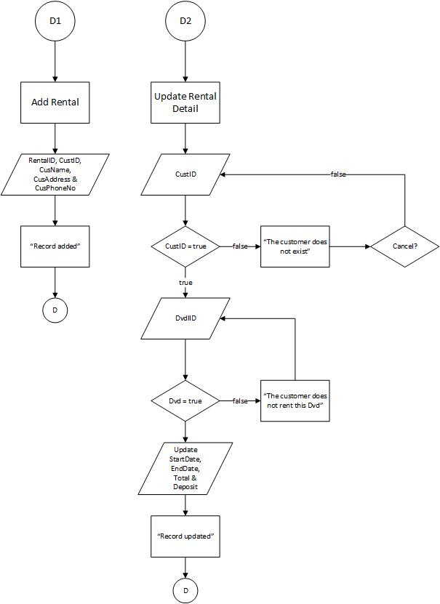

Slide 15
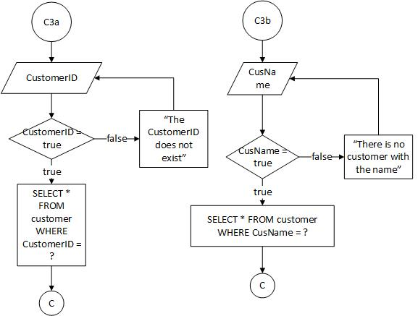

Slide 16
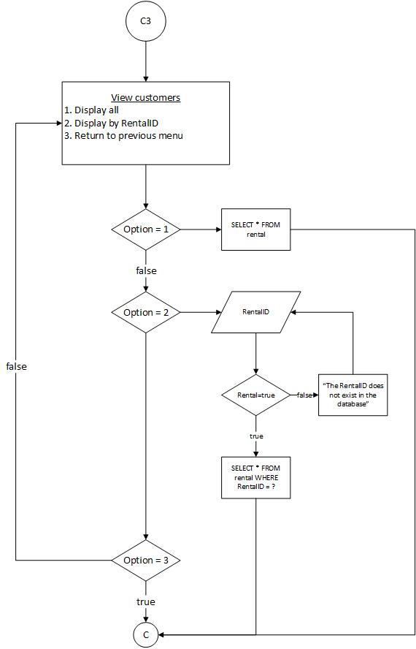

Slide 17
THANK YOU

